Slide 1
Best movie analyzer
Tartu university
Introduction to data science project
December 2022
Sharova Ekaterina, KAStierov Viacheslav

Slide 2

Introduction
1. Data of 6800 best movies from Internet Movie Database (IMDB)
2. Movies release 1986 - 2016
3. Movies score 0 - 10

Slide 3
Introduction
4. Structure of data
Name - name of the movie.
Rating - who can watch this movie.
Genre - internal structure of movie.
Year - released year.
Released - released date.
Score - IMDB score.
Votes - number of votes.
Director - director who was produced film.
Writer - person who wrote history.
Star - the main actor of the movie.
Budget - quantity of money spent to the film.
Gross - quantity of money movie earned.
Company - company that produced the movie.
Runtime - duration of the movie

Slide 4
Data analysis

Slide 5
Problems in eda
Outliers
We had to remove outliers that weren’t within 3 stds from a mean, because without this move we would consistently get faulty trends in the overall picture, due to some outliers that sometimes provide huge discrepancies without any meaning behind them

Slide 6
Minor issues
Heavy in memory usage and computations
For exploratory data analysis we utilized means of a lib called plotly. Which in turn meant that everything was very useful, interactive and heavily animated, but sometimes led to laggy experience and crashes.

Slide 7
Minor issues
Cognitive difficulties of figuring out meaningful data splits and data grouping
We wasted a lot of paper for ideation process and coming up with some hypotheses to test

Slide 8
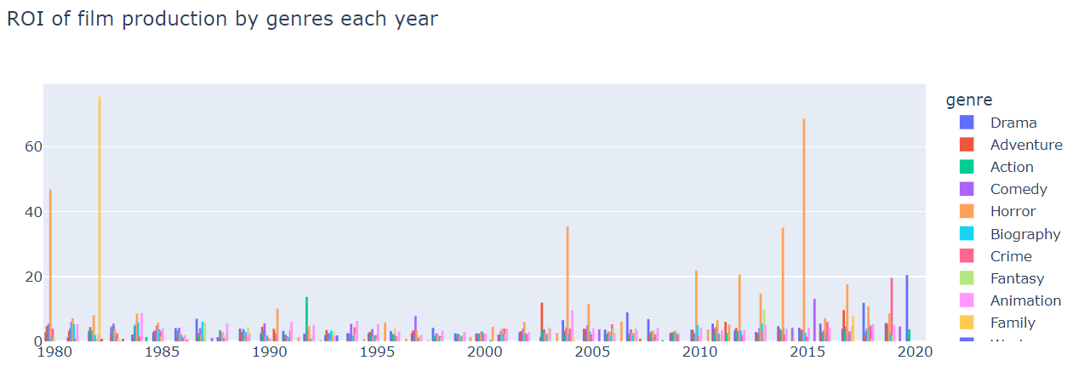
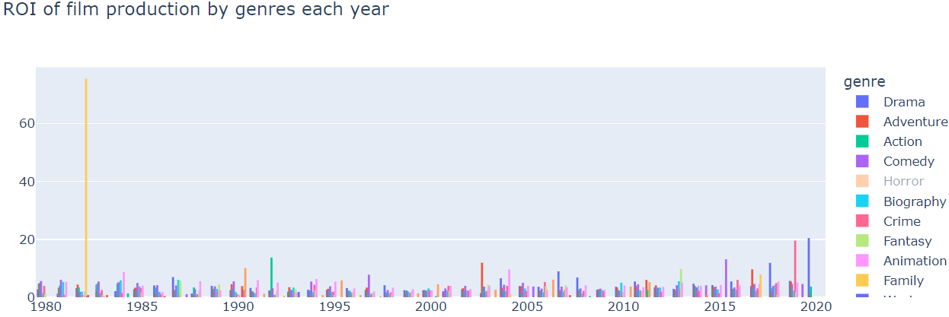
Interesting insights
Horror movies consistently bring good return on investment

Slide 9
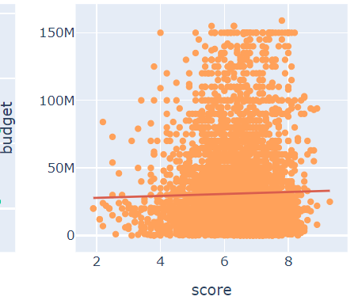
Interesting insights
Amount of money spent on production does not mean it will receive good viewer mark at all
Notes:
the money spent on production has no effect on the viewers vote

Slide 10
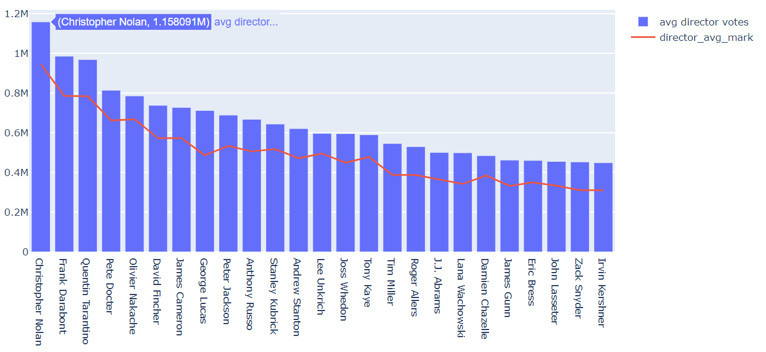
Interesting insights
Highest voted director is also the most voted director and it is not Guy Ritchie
Notes:
Who would've thought that the most voted director and the highest rated director is actually the same person ?
GIven that, it was also unexpected for me that it is not Guy Ritchie

Slide 11
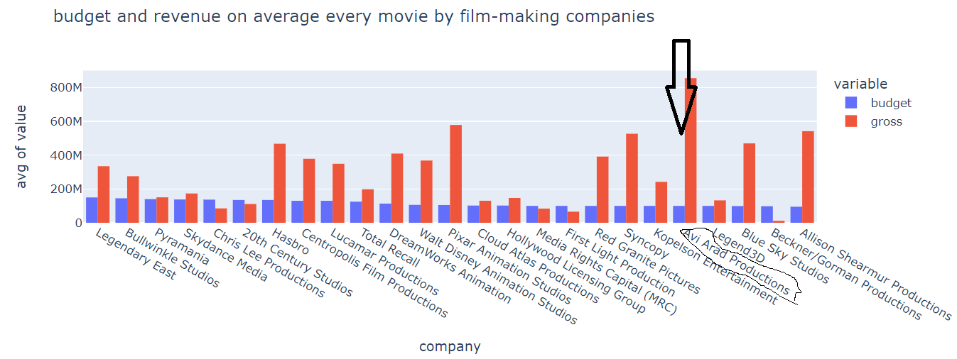
Interesting insights
Some unknown Avi Arab Productions tend to bring the biggest revenue and be exceptionally profitable, did you expect that ?

Slide 12
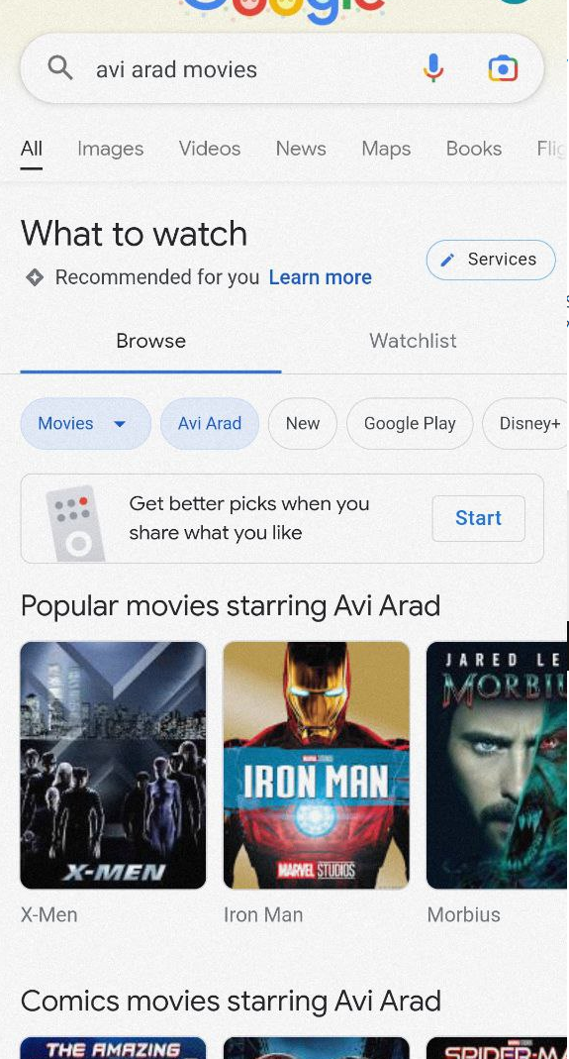
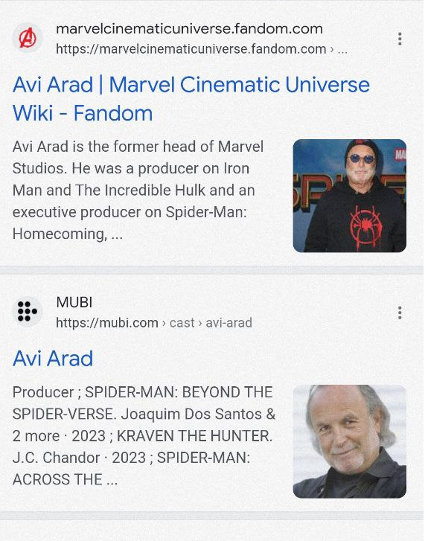
Interesting insights
Guess it’s not that much unexpected now
Notes:
Well, given that Avi Arad is the form a head of marvel studio it doesn’t sound that match unexpected now

Slide 13
Model creating

Slide 14

Problems
1. Cleaning data
There were a lot of different problems especially about missing values of features.
It should me mentioned that we could not use movies with missed score because our model would not study taking into consideration this data!
Also we have to delete features that could not be used for teaching our model (released, Director, Writer, Star, Company)
Such features as Genre and rating could be used for teaching model and there will be explanation how we should do it.

Slide 15
Problems
2. One-hot-encoding Genre and rating
Best way to do this it is understanding of this feature meaning. We can create just 3 feature from all columns that we will have after encoding.
find approach to sort rating feature after encoding.
find approach to sort Genre feature after encoding.
There is no approach to do it better then it done.

Slide 16
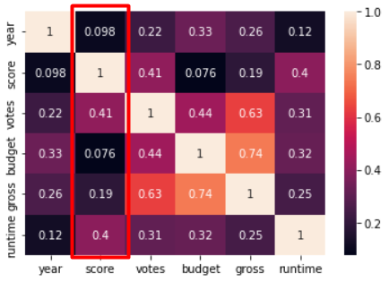
What features make biggest contribution in score formation?
SO…
Answer:
VOTES and Runtime

Slide 17
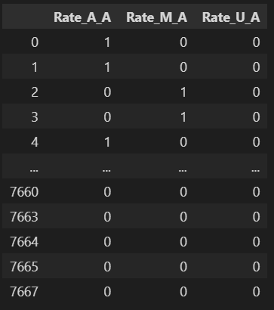
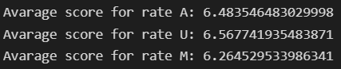
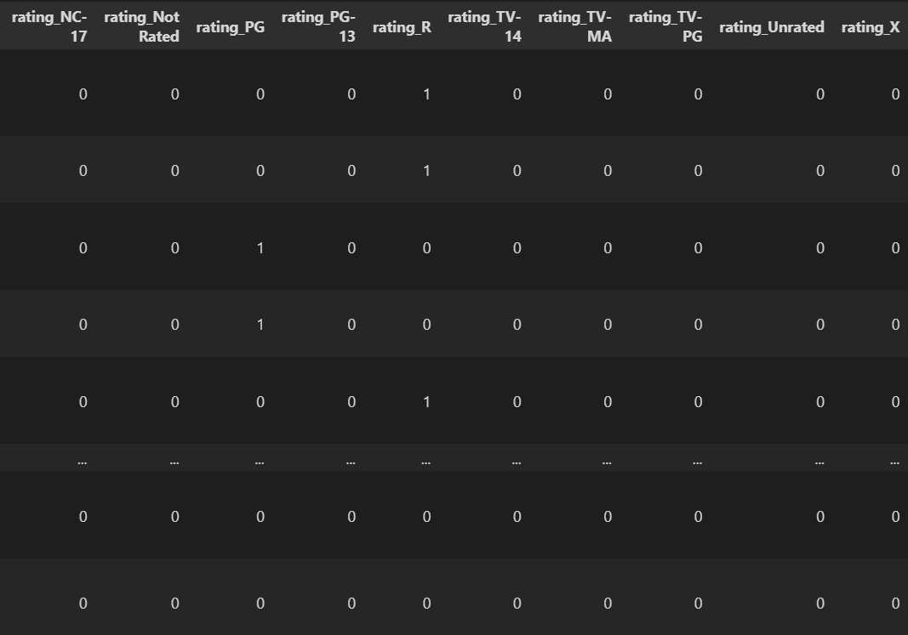
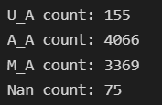
Is rating any influence to score?
now it is look like:
It was look like:
Average score:
Distribution:
More information: https://www.filmratings.com/RatingsGuide

Slide 18
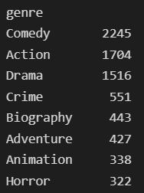
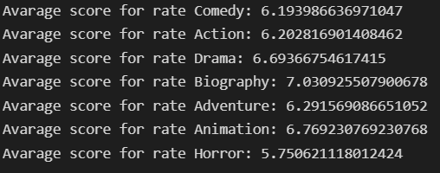
Is genre any influence to score?
The most popular genre is Comedy, Action and drama
BUT
The highest average score have biography, Animation and\DRAMA movies
then
If movie belongs to one of this genre this means it increases his chances to be higher scored!

Slide 19
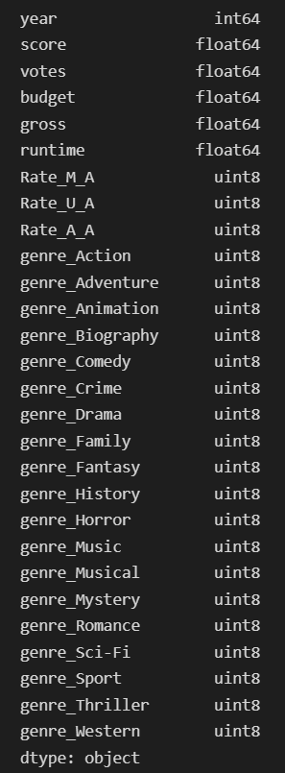
\Model creation
our data:
Our model will find score of movies taking into consideration next features:

Slide 20
\Model creation
Now use all data to create model and has such result:
RMSE on test data (25%) :
0.6998186340419529

Slide 21
\Model creation
We can reduce the RMSE if we increase the depth of the random forest regressor!
In the jyputer file named Model_movie_page you could find function to predict score of “your” movie. Try it!
:d

Slide 22


Slide 23
THANK you for attention!

